Slide 1
ARIT Market
손하민
이홍균
임현묵
한상미
Team #5 Project Proposal

Slide 2
#1 Background
#2 Development
#3 Design Concept
#4 Effects
#5 Schedule
Index

Slide 3

1. Background

Slide 4
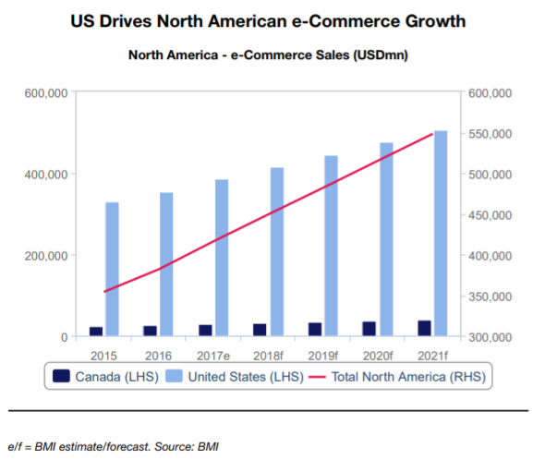
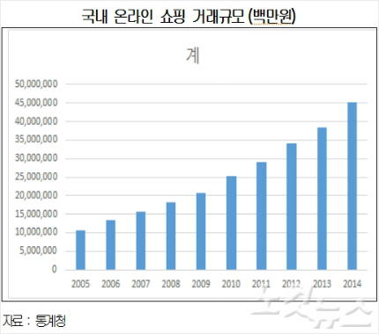
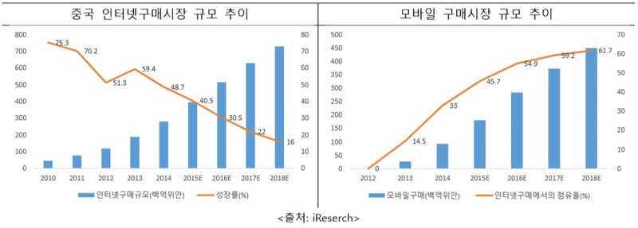
# Background
1. Background
Increasement of Internet Commerce

Slide 5
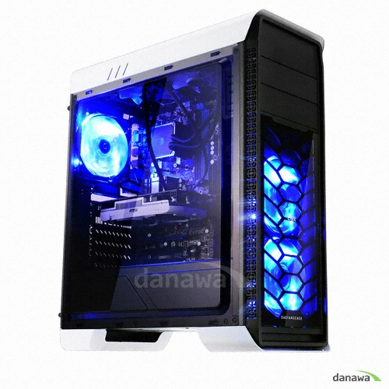
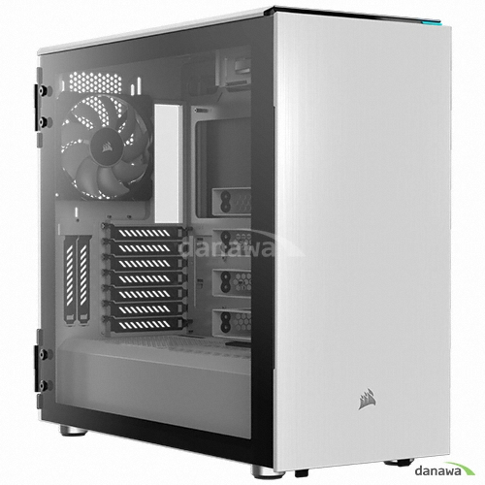
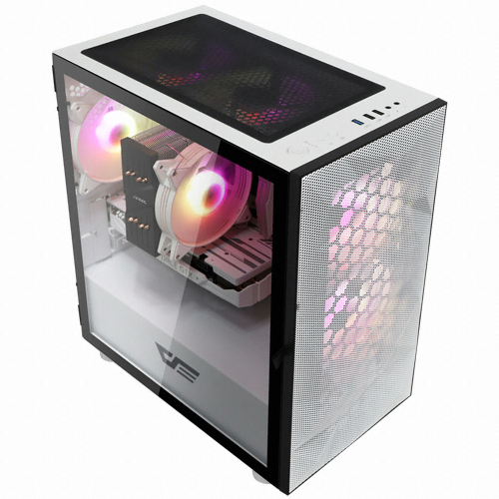


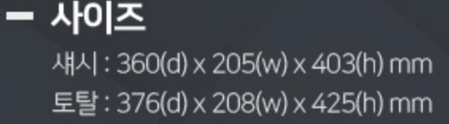
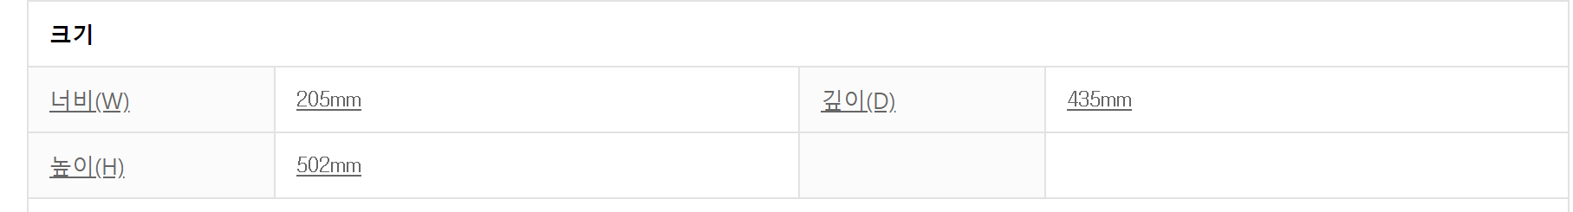
# Background
1. Background
Hard to know real size

Slide 6
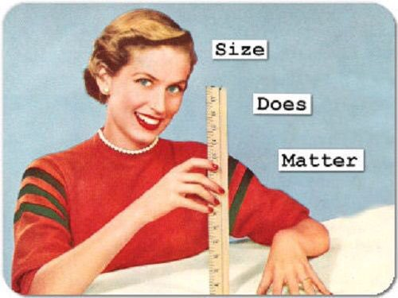
# Background
1. Background
To fit your room,
size is important

Slide 7

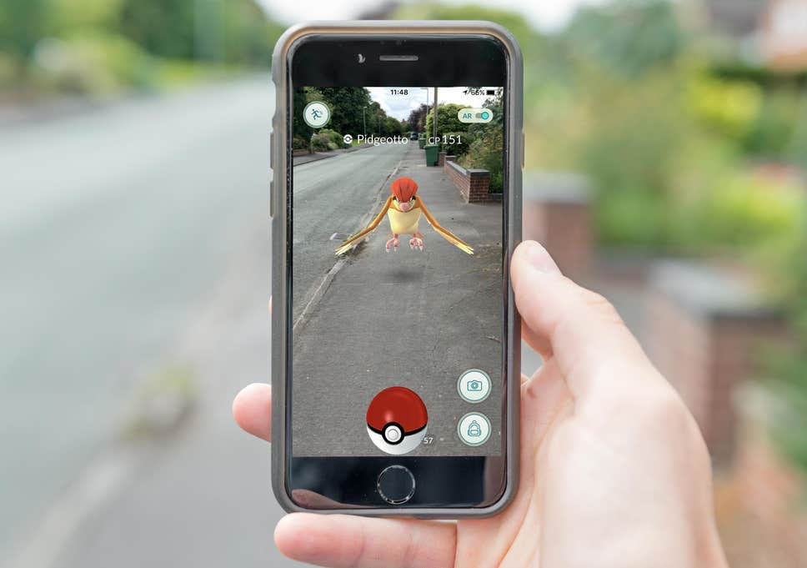

# Background
1. Background
Shopping Application
AR

Slide 8
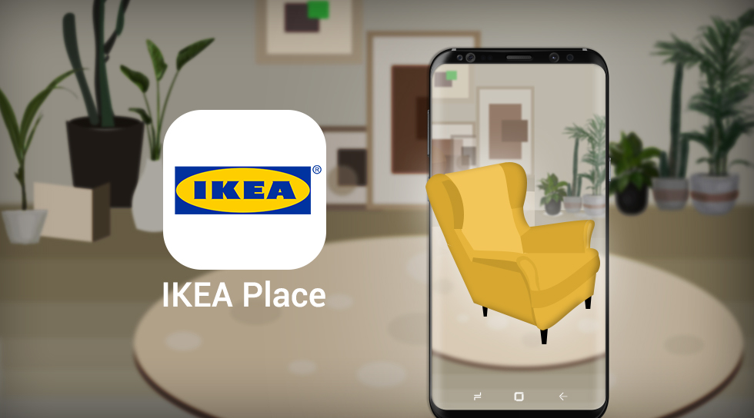

# Target software
1. Background
IKEA place
Not many products supported

Slide 9
2. Development

Slide 10
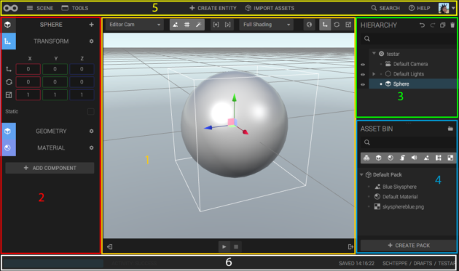
# Objective
2. Development
Focus on size,
Not shape
As we said,
SIZE does matter

Slide 11







# Development tools
2. Development
AR
Front-end
Back-end

Slide 12
# Functions
2. Development
Shopping Application
AR
Get products list
Review
Wish
Sort
Search
My page
Settings
Get product’s size

Slide 13
3. Design Concept

Slide 14
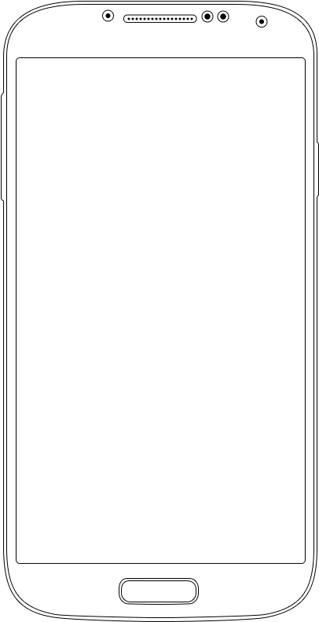





# Design Concept
3. Design Concept
Main Page
ARIT Market logo
State bar
mypage
search
home
menu
settings
Today’s Best
Hot Deal

Slide 15
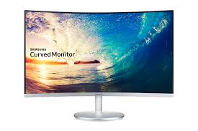
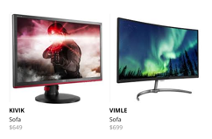
# Design Concept
3. Design Concept
Menu Page
Menu Page
detail categories
Ex) 27inch, 24inch, …
Category
Sorting by
Ex) latest, price, …
Detail category
Monitor
Sort
keyboard
Main categories
monitor
Best item
main body
Best >>
mouse
laptop
Products list

Slide 16
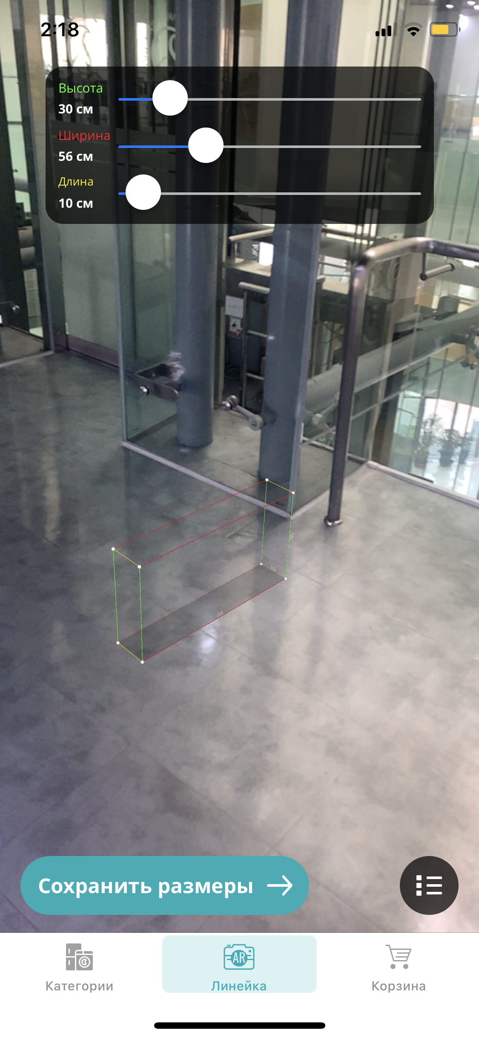
# Design Concept
3. Design Concept
Product Page
Product Page
AR object
Samsung
Curved Monitor
\800,000
Size
Review score
Details
Check
size
Review
Go Back to product

Slide 17
4. Effects

Slide 18
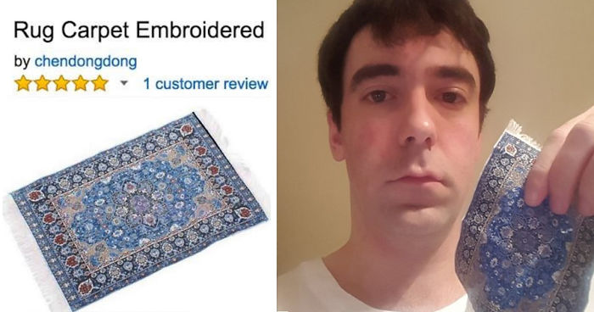
# Effects
4. Effects
There will be no shopping failure due to size

Slide 19

# Effects
4. Effects
Customers and sellers can be both happy

Slide 20
5. Schedule

Slide 21
# Schedule
5. Schedule
Integration
specification
development
Acceptance Test
~Week8
~Week 14
~Final presentation

Slide 22
Q&A
Thank You

